Slide 1
The Rady School of Management
MGT 103 Lecture #13
The ”Place”- Marketing Channels & Supply Chains
Game of Thrones Case Study- Multi-Channel Marketing
February 26, 2020

Slide 2
Announcements
Rady Labs- please complete by no later than March 4th.
Office hours reminder - 1:30 _ 2:30 p.m. on Monday, March 2nd. 2E108 Rady Undergrad Offices
CAPE Professor Evaluation
March 4th to March 15th You will receive several email reminders to complete the survey
EXTRA CREDIT !
2% points towards Final Exam Grade for completion of CAPE (take a screen shot of ”completed” page, send to Alli)
3% points towards Final Exam Grade if >90% of the class completes the CAPE survey!

Slide 3


EDDIE BAUER: THE “BRICK, CLICK, AND FLIP” PICK FOR THE ACTIVE OUTDOOR ENTHUSIAST
Eddie Bauer: Multichannel Marketing Strategy
370 Stores, Web, Catalogs
Brick, Click, and Flip
Complex Supply Chain
© McGraw-Hill Education/Mike Hruby, photographer
Eddie Bauer
Website

Slide 4
NATURE AND IMPORTANCE OF MARKETING CHANNELS CUSTOMER VALUE CREATED BY INTERMEDIARIES
Marketing Channel
Products and Services Flow Through Intermediaries
Functions Intermediaries Perform:
Transactional Function
Logistical Function
Facilitating Function
Utilities Received by Consumers:
Time, Place, Form

Slide 5
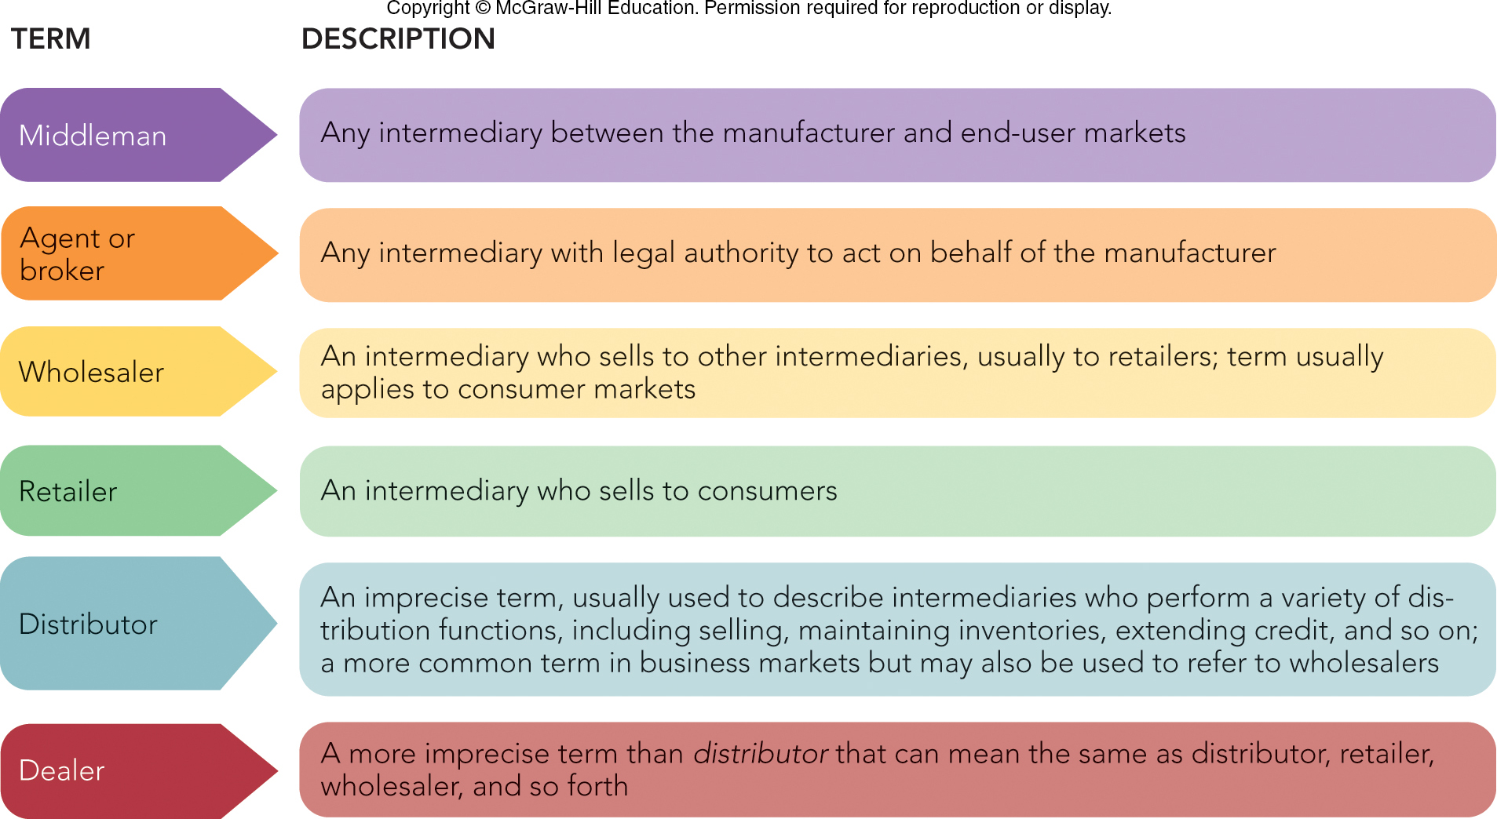
FIGURE 15-1 Terms used for marketing intermediaries vary in specificity and use in consumer and business markets.
Jump to Appendix 1 long image description

Slide 6
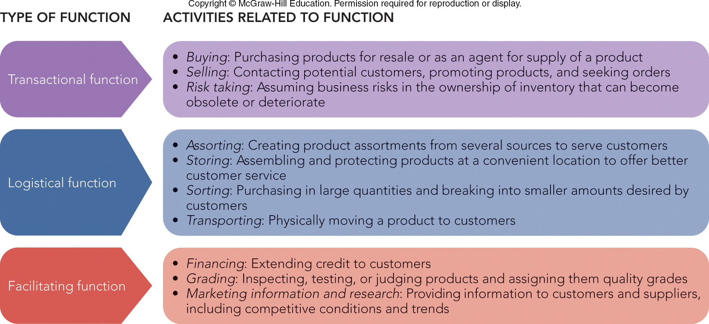
FIGURE 15-2 Marketing channel intermediaries perform three functions, each consisting of different activities.

Slide 7
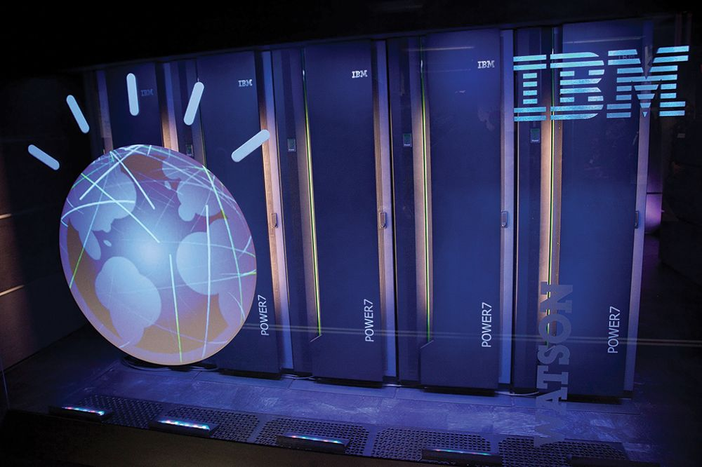
MARKETING CHANNEL STRUCTURE AND ORGANIZATION MARKETING CHANNELS FOR CONSUMER PRODUCTS
Direct Channel
Producer  Consumer
Indirect Channel
Producer  Retailers  Consumers
Producer  Wholesalers  Retailers  Consumers
Producer  Agents  Wholesalers  Retailers  Consumers
© Ben Hider/Getty Images

Slide 8
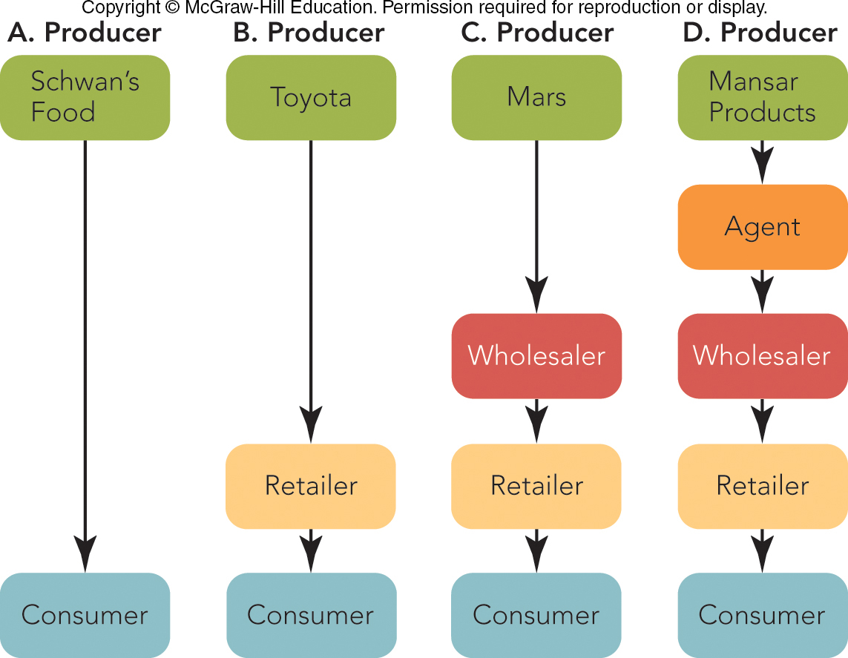
FIGURE 15-3 Common marketing channels for consumer products and services by the kind and number of intermediaries.

Slide 9
MARKETING CHANNEL STRUCTURE AND ORGANIZATION MARKETING CHANNELS FOR BUSINESS OFFERINGS
Direct Channel
Producer  Industrial User
Indirect Channel
Producer  Industrial Distributor  Industrial User
Producer  Agents  Industrial User
Producer  Agents  Industrial Distributors  Industrial User

Slide 10
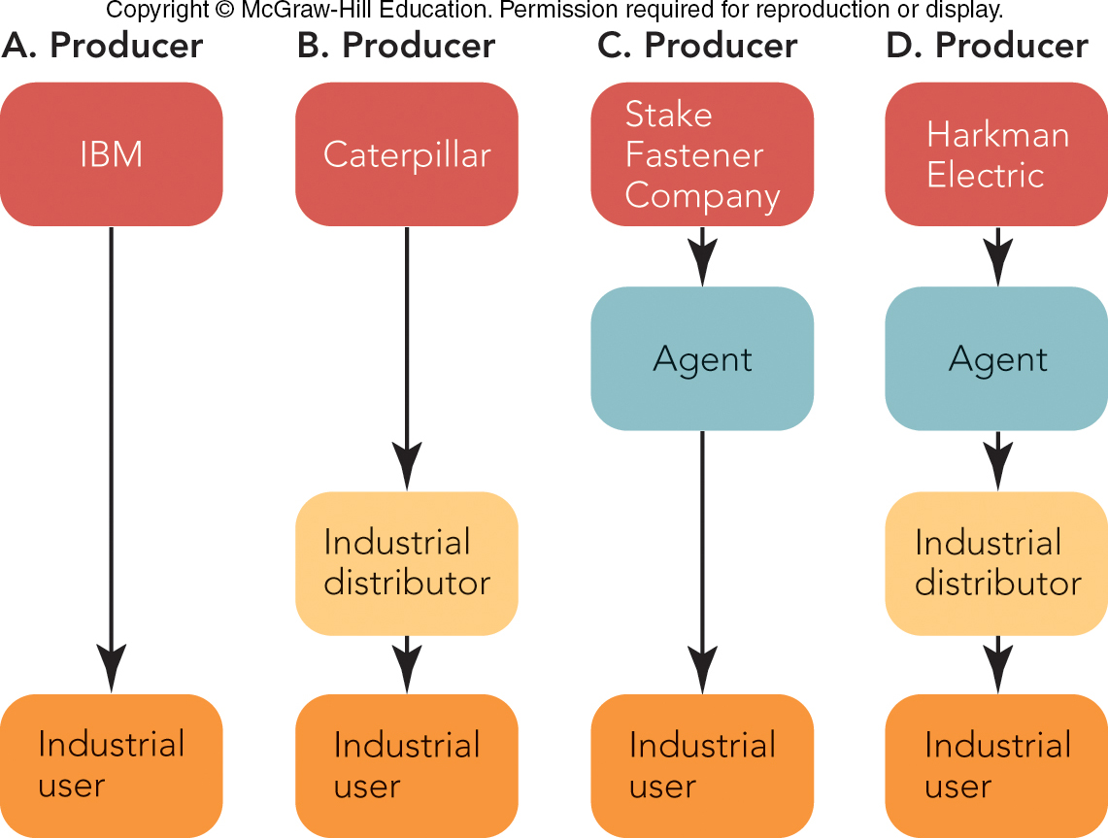
FIGURE 15-4 Common marketing channels for business products and services by the kind and number of intermediaries.

Slide 11
INTERNET MARKETING CHANNELS
Internet Marketing Channels:
Combine Electronic and Traditional Intermediaries
Create Time, Place, Form, and Possession Utility for Buyers
Also Includes Services Such as Car Rental, Financial Securities, and Insurance

Slide 12
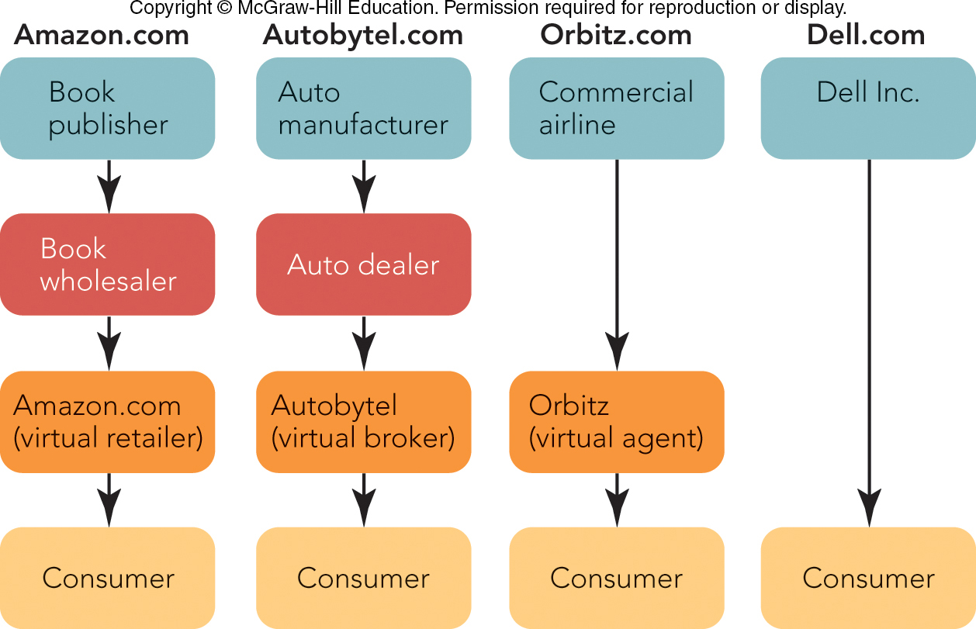
FIGURE 15-5 Consumer electronic marketing channels are similar to those for consumer products and services.

Slide 13

DIRECT AND MULTICHANNEL MARKETING
Direct Marketing Channels
Indirect Marketing Channels
Multichannel Marketing
Dual Distribution
Strategic Channel Alliances
© Rob Crandall/Alamy Stock Photo

Slide 14
MARKETING CHANNEL CHOICE AND MANAGEMENT FACTORS AFFECTING CHANNEL CHOICE
Choose Channel by:
Best Coverage of Target Market?
Best Satisfy Buyers’ Requirements?
Most Profitable?
Target Market Coverage (Density)
Intensive Distribution
Exclusive Distribution
Selective Distribution

Slide 15
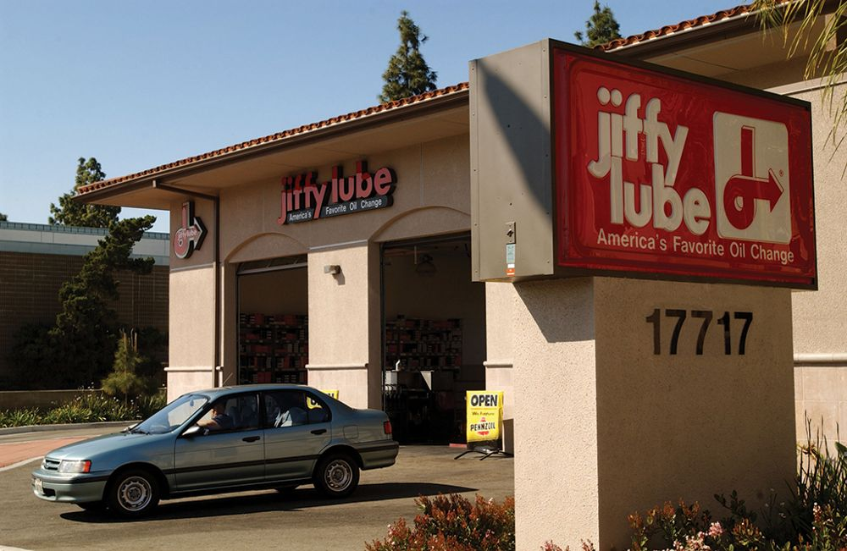
MARKETING CHANNEL CHOICE AND MANAGEMENT CHANNEL CHOICE CONSIDERATIONS
Buyer Requirements
Information
Variety
Convenience
Pre- or Post-Sale Service
Profitability
How do I maximize profits? (high revenue & low costs….)
©David McNew/Getty Images

Slide 16
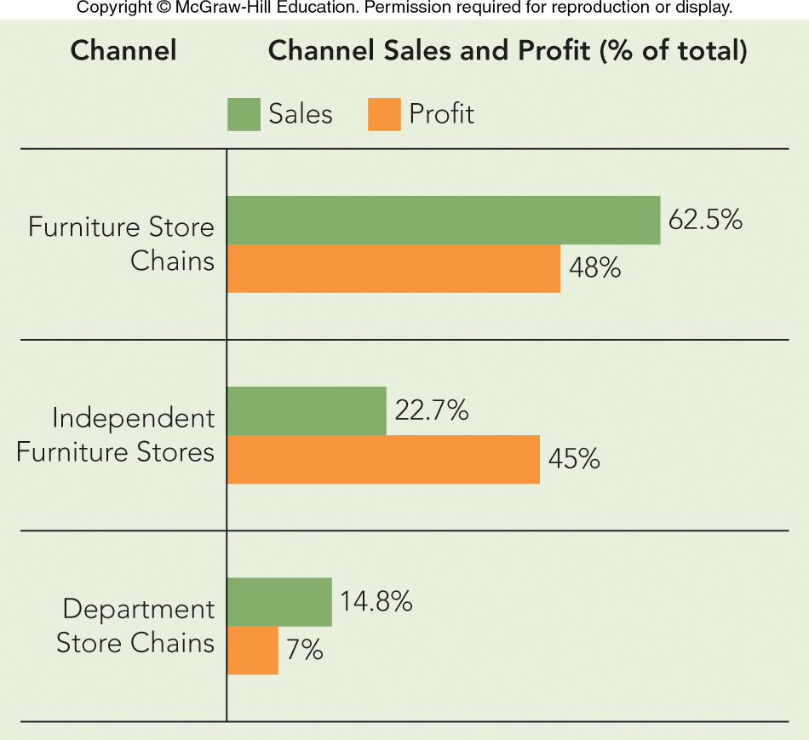
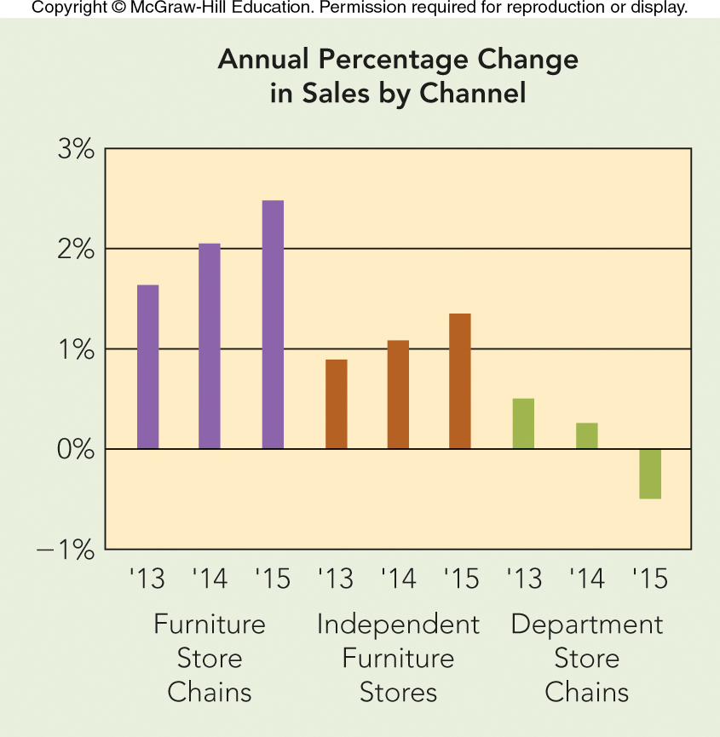
APPLYING MARKETING METRICS Channel Sales and Profit at Charlesburg Furniture
Should Charlesburg Furniture Allocate Marketing Funds Based on Channel Dollar Sales or on Profit?

Slide 17
LOGISTICS AND SUPPLY CHAIN MANAGEMENT KEY CONCEPTS
Logistics
Logistics Management
Customer Requirements
Flow
Cost-Effective
Customer Service
Supply Chain
Supply Chain Management
Integration Across Firms

Slide 18
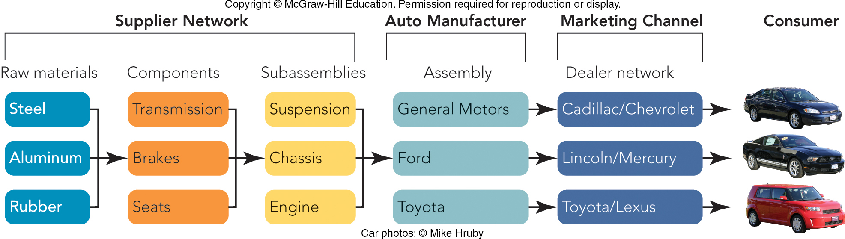
FIGURE 15-9 The automotive supply chain includes thousands of firms that provide the functional components, parts, etc. in a car.

Slide 19
TWO CONCEPTS OF LOGISTICS MANAGEMENT IN A SUPPLY CHAIN
Total Logistics Cost
Includes Expenses for Transportation, Inventory, Materials Handling, and More
Customer Service
The Ability to Satisfy Users in Terms of Time, Dependability, Communication, and Convenience

Slide 20
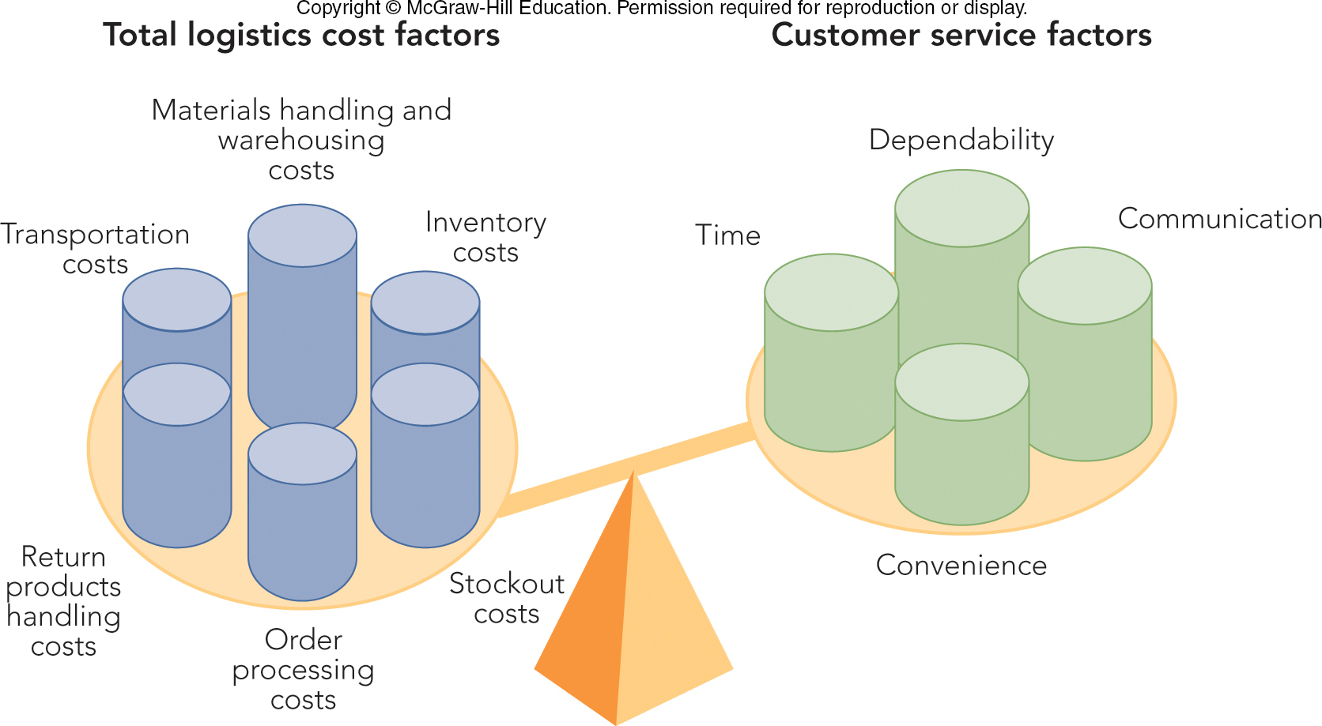
FIGURE 15-10 Supply chain managers balance total logistics cost factors against customer service factors.

Slide 21
VIDEO CASE 15 AMAZON: DELIVERING THE EARTH’S BIGGEST SELECTION!
Amazon Video Case

Slide 22
The Rady School of Management
A case study in Multi-Channel Marketing

Slide 23
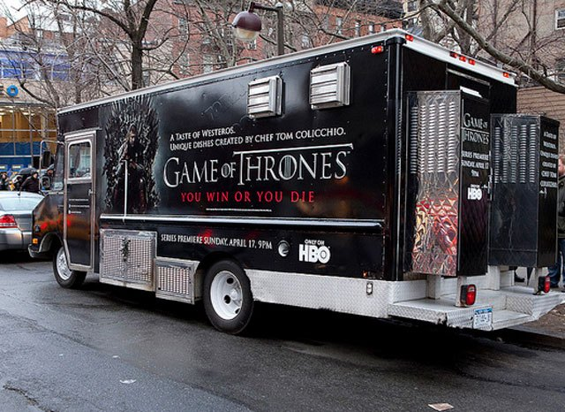


Game of Thrones - HBO

Slide 24
The Rady School of Management
MGT 103 Lecture #8
The ”Place”- Marketing Channels
Supply Chain Management
Retailing & Wholesaling
November 21, 2018

Slide 25
Group Work…..
Assemble in your work groups for Marketing Plan Project
Review key marketing channels used by HBO to promote Game of Thrones
What additional promotions would you design using the existing channels
What additional marketing channels would you use to promote GOT. Why? How would you measure ROI?
10 minutes to complete

Slide 26
Final Thoughts for next week……
Reading Assignment – Read Chapters 16,17
Homework #2 – eBook Reader due March 4th, reach out to Alli or I with questions

Slide 27
The Rady School of Management
MGT 103 Lecture #13
The ”Place”- Marketing Channels & Supply Chains
Game of Thrones Case Study- Multi-Channel Marketing
February 26, 2020

